Slide 1
AMARE COMPENSATION Presentation

Slide 2
Amare Compensation Plan Overview
Focus on customer gathering
Provide DIRECTION
and FOCUS
FAIR and BALANCED
Never penalize success
Reward progress
Reward leadership
Incentivize teamwork
Provide EARLY REWARDS
(for spare time involvement)
Provide UNLIMITED REWARDS (for career income potential)
What makes for a great compensation plan?
ALL OF THIS

Slide 3
AMARE Compensation
Plan
Personal Volume bonus
Heart Start
ME & THREE
EARN SPECIAL BONUSES & REWARDS THROUGH OUR UNIQUE COMPENSATION PLAN
ME & THREE
UNILEVEL
Bonus Pools AND SO MUCH MORE!

Slide 4


CUSTOMER
Use a Personal Promo Code & Get
$10 OFF
Your First Order
Enjoy premium, natural, effective products
WELLNESS
PARTNER
$69.95/year
Enjoy premium, natural, effective products
Share Amare in a fun, purposeful, and engaging way, while earning an income

Slide 5

100% SATISFACTION GUARANTEE
EVALUATE THE PRODUCTS FOR YOURSELF RISK FREE
We offer a complete line of products focused on mental wellness. You can evaluate our products for yourself and if at any time you are not completely satisfied, we will fully refund your purchase. Period.
Visit amare.com to view full return policy.

Slide 6

WELLNESS
PARTNER
$69.95/year
EARN FREE TRIPS!
Earn FREE trips!

Slide 7
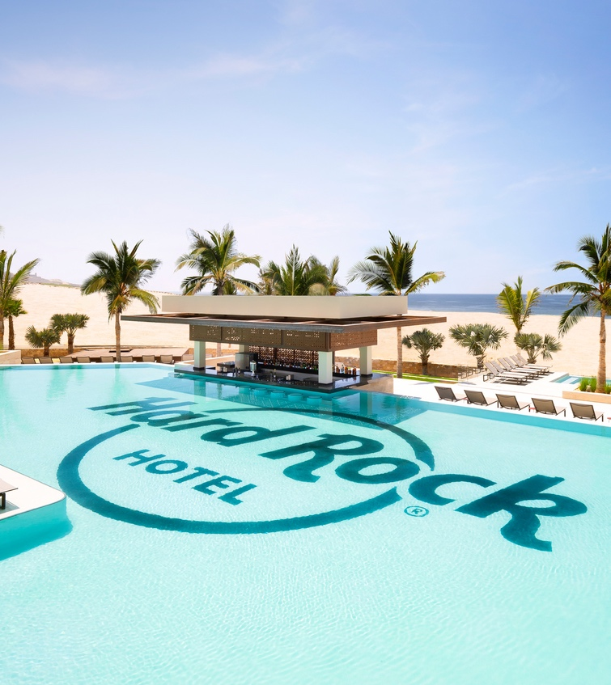
Hard Rock Los Cabos
An All-Inclusive Resort
NOV. 15-20, 2021
New Customers &
Wellness Partners = POINTS!
Enough POINTS = FREE TRIP!

Slide 8
YOU
CUSTOMERS
(C) 1st Level
PARTNERS
(p) 1st Level
PERSONAL VOLUME (PV) =
Your personal purchase and that of your personally enrolled Customers
PERSONAL TEAM VOLUME (PTV) =
Your personal purchase and that of your personally enrolled Customers and Partners
(Goal should be 600 PTV for qualifications)
ORGANIZATIONAL VOLUME (OV) =
ALL the Volume from You, Your Customers and Partners in your downline to unlimited depth.
“LEGS” =
The number of personally enrolled Wellness Partners
(OV Determines Rank along with the Leg Requirements)

Slide 9
You have 14 days to give away sponsorship and move them to someone else if desired.
YOU
You can give Enroller status at any time, but it can only be given one time and is permanent.
NO GAMES ALLOWED: Rank qualifications follow the ENROLLMENT TREE but do not have to be personally sponsored to count toward advancements.
However, when sponsor and enroller are split, rank qualification is only counted for the enroller.
CSTOMERS
(C) 1st Level
SPONSOR
ENROLLER

Slide 10
PERSONAL
CUSTOMER BONUS
This bonus is paid MONTHLY on the 15th of each month for the previous calendar month’s Personal Volume!

Slide 11
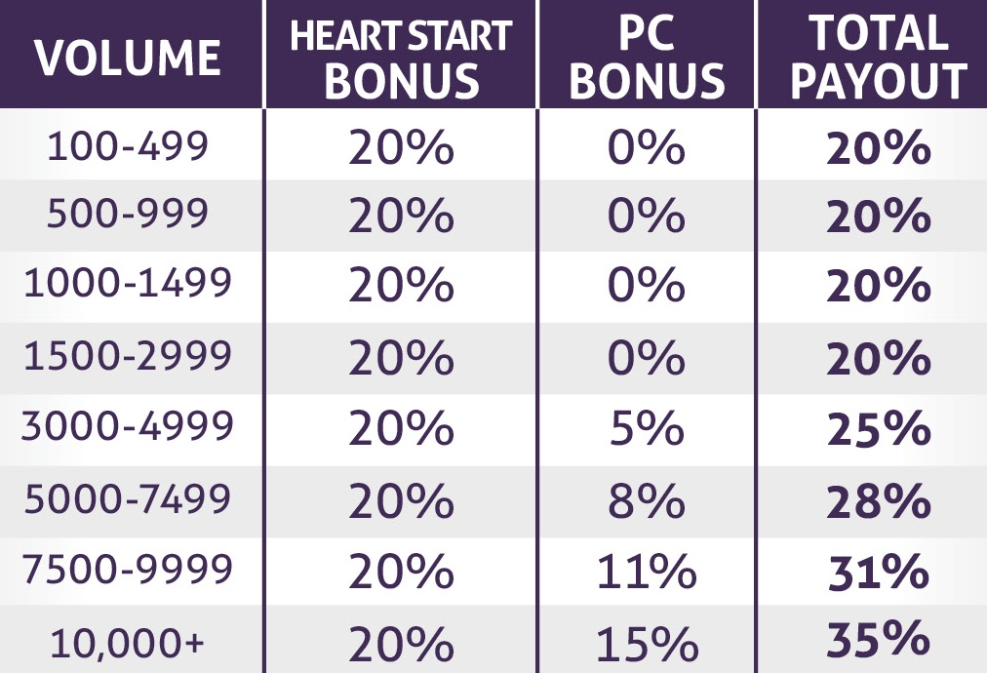
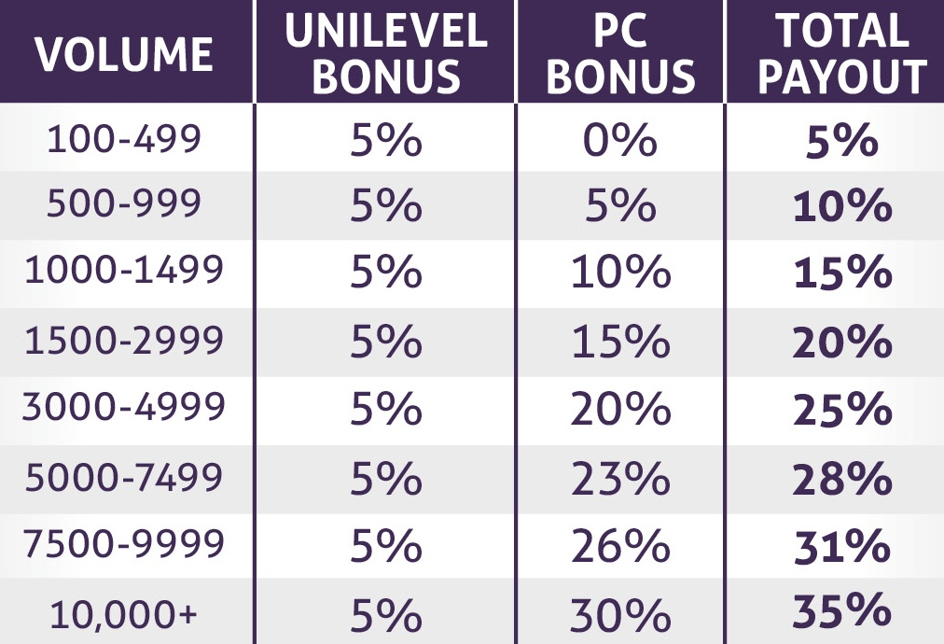
PERSONAL
CUSTOMER BONUS
Personal
Customer Volume Bonus during your customer’s Heart Start Period*
*Heart Start period is the first 60 days from enrollment date.
The more customers you have, the more volume you create, the more your income percentages increase!
Up to a total of 35% of your PV.
Personal
Customer Volume Bonus after your customer’s Heart Start Period*

Slide 12
Me & Three
BONUS
This bonus is paid MONTHLY on the 15th of each month for the previous calendar month’s Subscribe & Save autoship orders!

Slide 13

ME & THREE BONUS
YOU
+600 PTV
When you have 3 personal customers (or partners) who have at least a 100+ PV Subscribe & Save and at least 600 in Personal Team Volume, you receive:
100+ PV
C/P
C/P
C/P
$135.00
EVERY MONTH!
100+ PV SS
100+ PV SS
100+ PV SS
You Earn $135.00 Every Month!
(These 3 may be the same or different customers or partners to qualify for this bonus each month!)

Slide 14
ME & THREE BONUS
YOU
+600 PTV
+35%
When you have 3 personal customers (or partners) who have at least a 100+ PV Subscribe & Save and at least 600 in Personal Team Volume, you receive:
100+ PV
» 1st GOAL:
Sponsor 3 Customers (or Partners)
C/P
C/P
C/P
$135.00
EVERY MONTH!
100+ PV SS
100+ PV SS
100+ PV SS
» 600 OV:
Approx. Income = $200+/Month
You Earn $135.00 Every Month!
(These 3 may be the same or different customers or partners to qualify for this bonus each month!)

Slide 15
ME & THREE BONUS
YOU
+600 PTV
When you have 3 personal customers (or partners) who have at least a 100+ PV Subscribe & Save and at least 600 in Personal Team Volume, you receive:
100+ PV
P
P
P
$135.00
EVERY MONTH!
$250.00
EVERY MONTH!
+
Earned $135
Earned $135
Earned $135
1
2
3
1
2
3
1
2
3
Earn an additional $250.00 Every Month!
$385.00 Every Month!

Slide 16
ME & THREE BONUS
YOU
+600 PTV
2400 OV
Approx. Income: $500+/month
When you have 3 personal customers (or partners) who have at least a 100+ PV Subscribe & Save and at least 600 in Personal Team Volume, you receive:
100+ PV
P
P
P
$135.00
EVERY MONTH!
$250.00
EVERY MONTH!
+
Earned $135
Earned $135
Earned $135
1
2
3
1
2
3
1
2
3
Earn an additional $250.00 Every Month!
$385.00 Every Month!

Slide 17
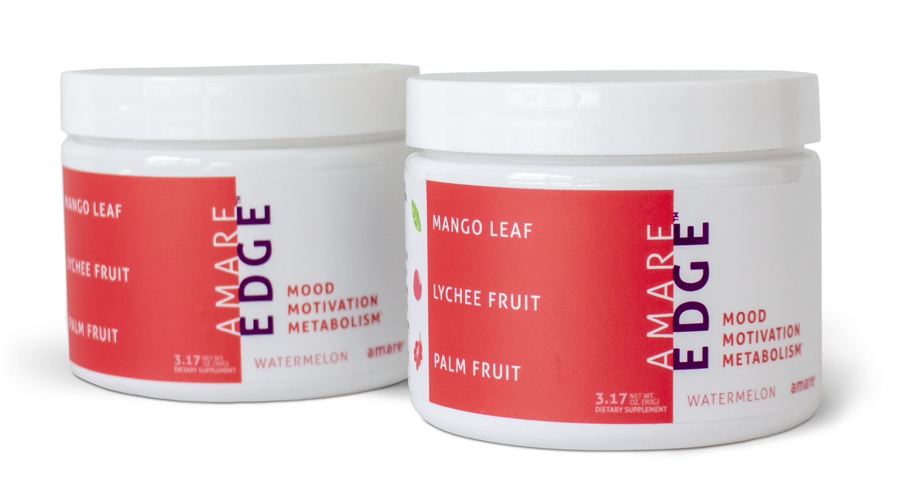
AMARE EDGE
YOU
Gathering customers on our Amare EDGE 2-Pack is the way to build strong, long-term residual income!
Our best Partners will come from our base of satisfied customers!
+600 PTV
100+ PV
C/P
C/P
C/P
100+ PV SS
100+ PV SS
100+ PV SS
Our Building Blocks!
EDGE 2-Pack = 100 PV.

Slide 18
AMARE EDGE
YOU
Gathering customers on our Amare EDGE 2-Pack is the way to build strong, long-term residual income!
Our best Partners will come from our base of satisfied customers!
+600 PTV
100+ PV
C/P
C/P
C/P
100+ PV SS
100+ PV SS
100+ PV SS
‘Me & Three’
SUCCESS UNIT
EDGE 2-Pack = 100 PV.

Slide 19
HEART START
BONUS
This bonus is paid WEEKLY!

Slide 20
YOU
HEART START
1st LEVEL
C/P
C/P
C/P
C/P
C
P
20%
C/P
C/P
C/P
C/P
Every Customer & Partner you enroll is considered your 1st level C/P.
Any orders placed in the first 60 days of all personally enrolled New Customers or Partners, you will earn a full 20% of the CV through our Heart Start bonus
THEIR FIRST 60 DAYS
(Unilevel Bonus Schedule applies to all orders after the first 60 days.)

Slide 21
YOU
HEART START
1st LEVEL
C/P
C/P
C/P
C/P
C
P
20%
C/P
C/P
C/P
C/P
C/P
C/P
C/P
C/P
2nd LEVEL
C
P
10%
C/P
C/P
C/P
C/P
As your 1st Level Partners enroll
others, any orders placed in their first 60 days, you will earn a full 10% of the CV through our Heart Start bonus.
C/P
C/P
C/P
C/P
5%
C/P
C/P
C/P
C/P
(Unilevel Bonus Schedule applies to all orders after the first 60 days.)

Slide 22
7 Level ‘UNILEVEL’ Structure
This bonus is paid MONTHLY on the 15th of each month for the previous calendar month’s Personal Volume!

Slide 23
YOU
LEVEL
FIRST
60
DAYS
HEART START
UNILEVEL
AFTER
60
DAYS
1
20%
5%
2
10%
5%
3
5%
5%
4
5%
5
5%
*Leader rank and above pays 5% seven levels deep
6
5%
7
5%

Slide 24
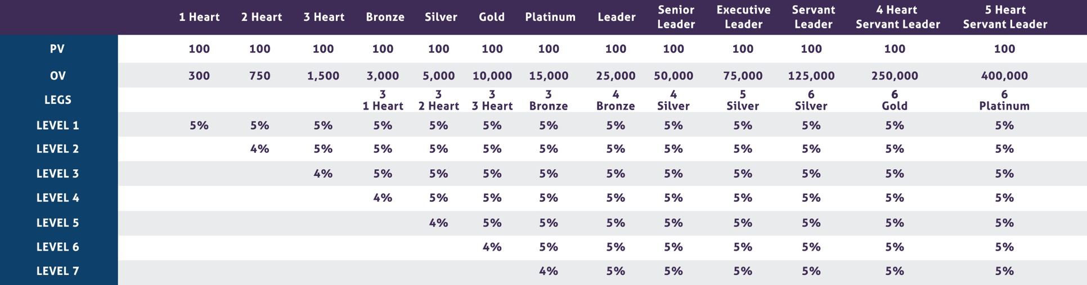
UNILEVEL BASE BONUSES
7 Levels of 5% Each
*Some legs must be personally enrolled starting at Leader Rank and up.

Slide 25
REVENUE SHARING BONUS POOLS
This bonus is paid MONTHLY on the 15th of each month for the previous calendar Company wide Commissionable Volume!

Slide 26
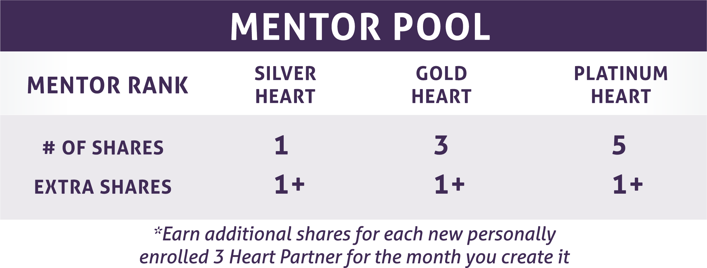
Revenue sharing bonus pools
2%
Of all
company cv

Slide 27
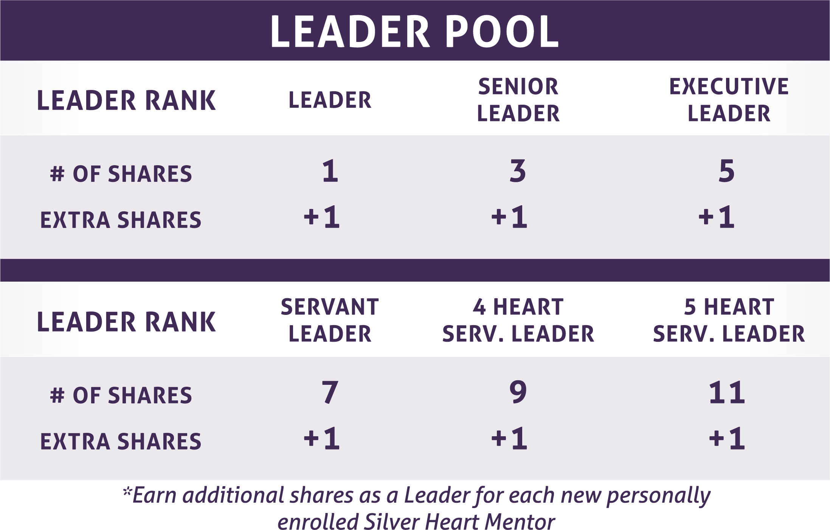
Revenue sharing bonus pools
2%
Of all
company cv

Slide 28
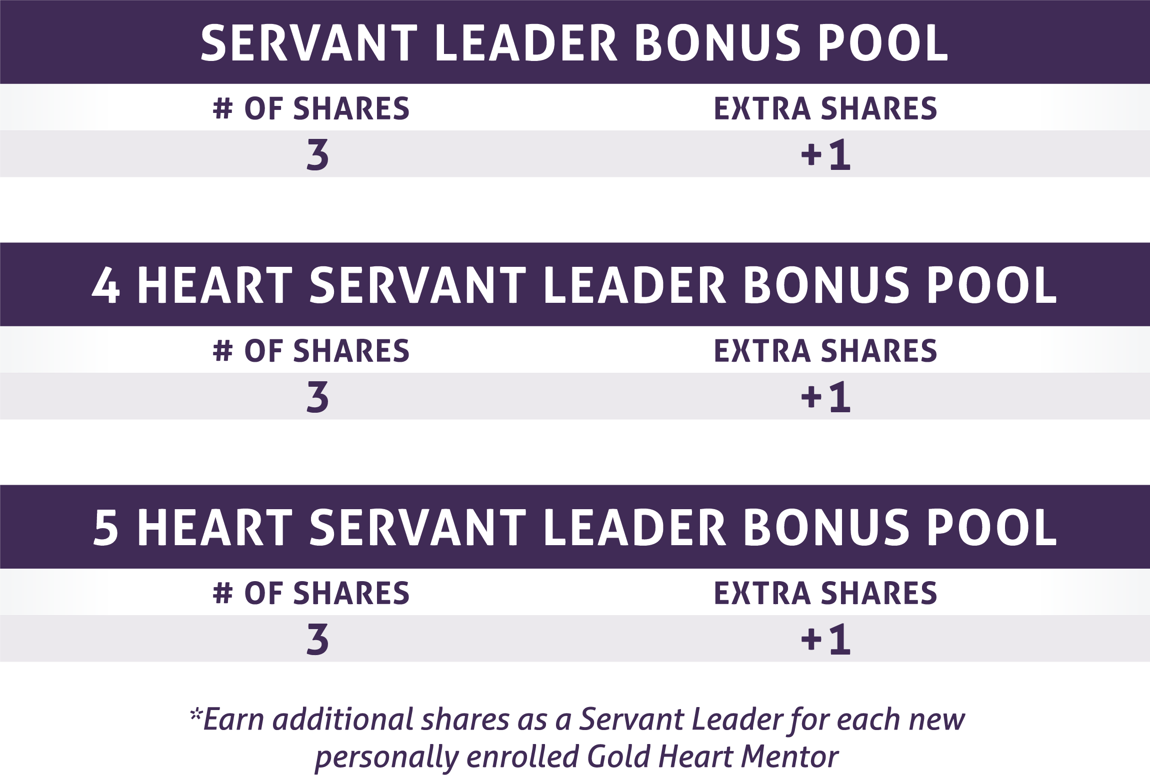
Revenue sharing bonus pools
1%
1%
3%
1%
Of all
company cv

Slide 29
GO forward infinity bonus
This bonus is paid MONTHLY on the 15th of each month for the previous calendar month’s Organizational “Coded” Volume!

Slide 30
GO FORWARD INFINITY BONUS
YOU
4 HEART SERVANT LEADER
5 HEART SERVANT LEADER
SERVANT LEADER
100+ PV
1%
2%
3%
P
P
P
P
P
P
Earned $135
Earned $135
Earned $135
1
2
3
1
2
3
1
2
3
Paid on all Partner Legs you start after you achieve Servant Leader Rank
Unlimited Depth!
Paid on all Partner Legs you start after you achieve 4 Heart Servant Leader Rank
Unlimited Depth!
Paid on all Partner Legs you start after you achieve 5 Heart Servant Leader Rank
Unlimited Depth!
All Go Forward Infinity Bonuses are paid in addition to all other commissions provided in our Compensation Plan!

Slide 31
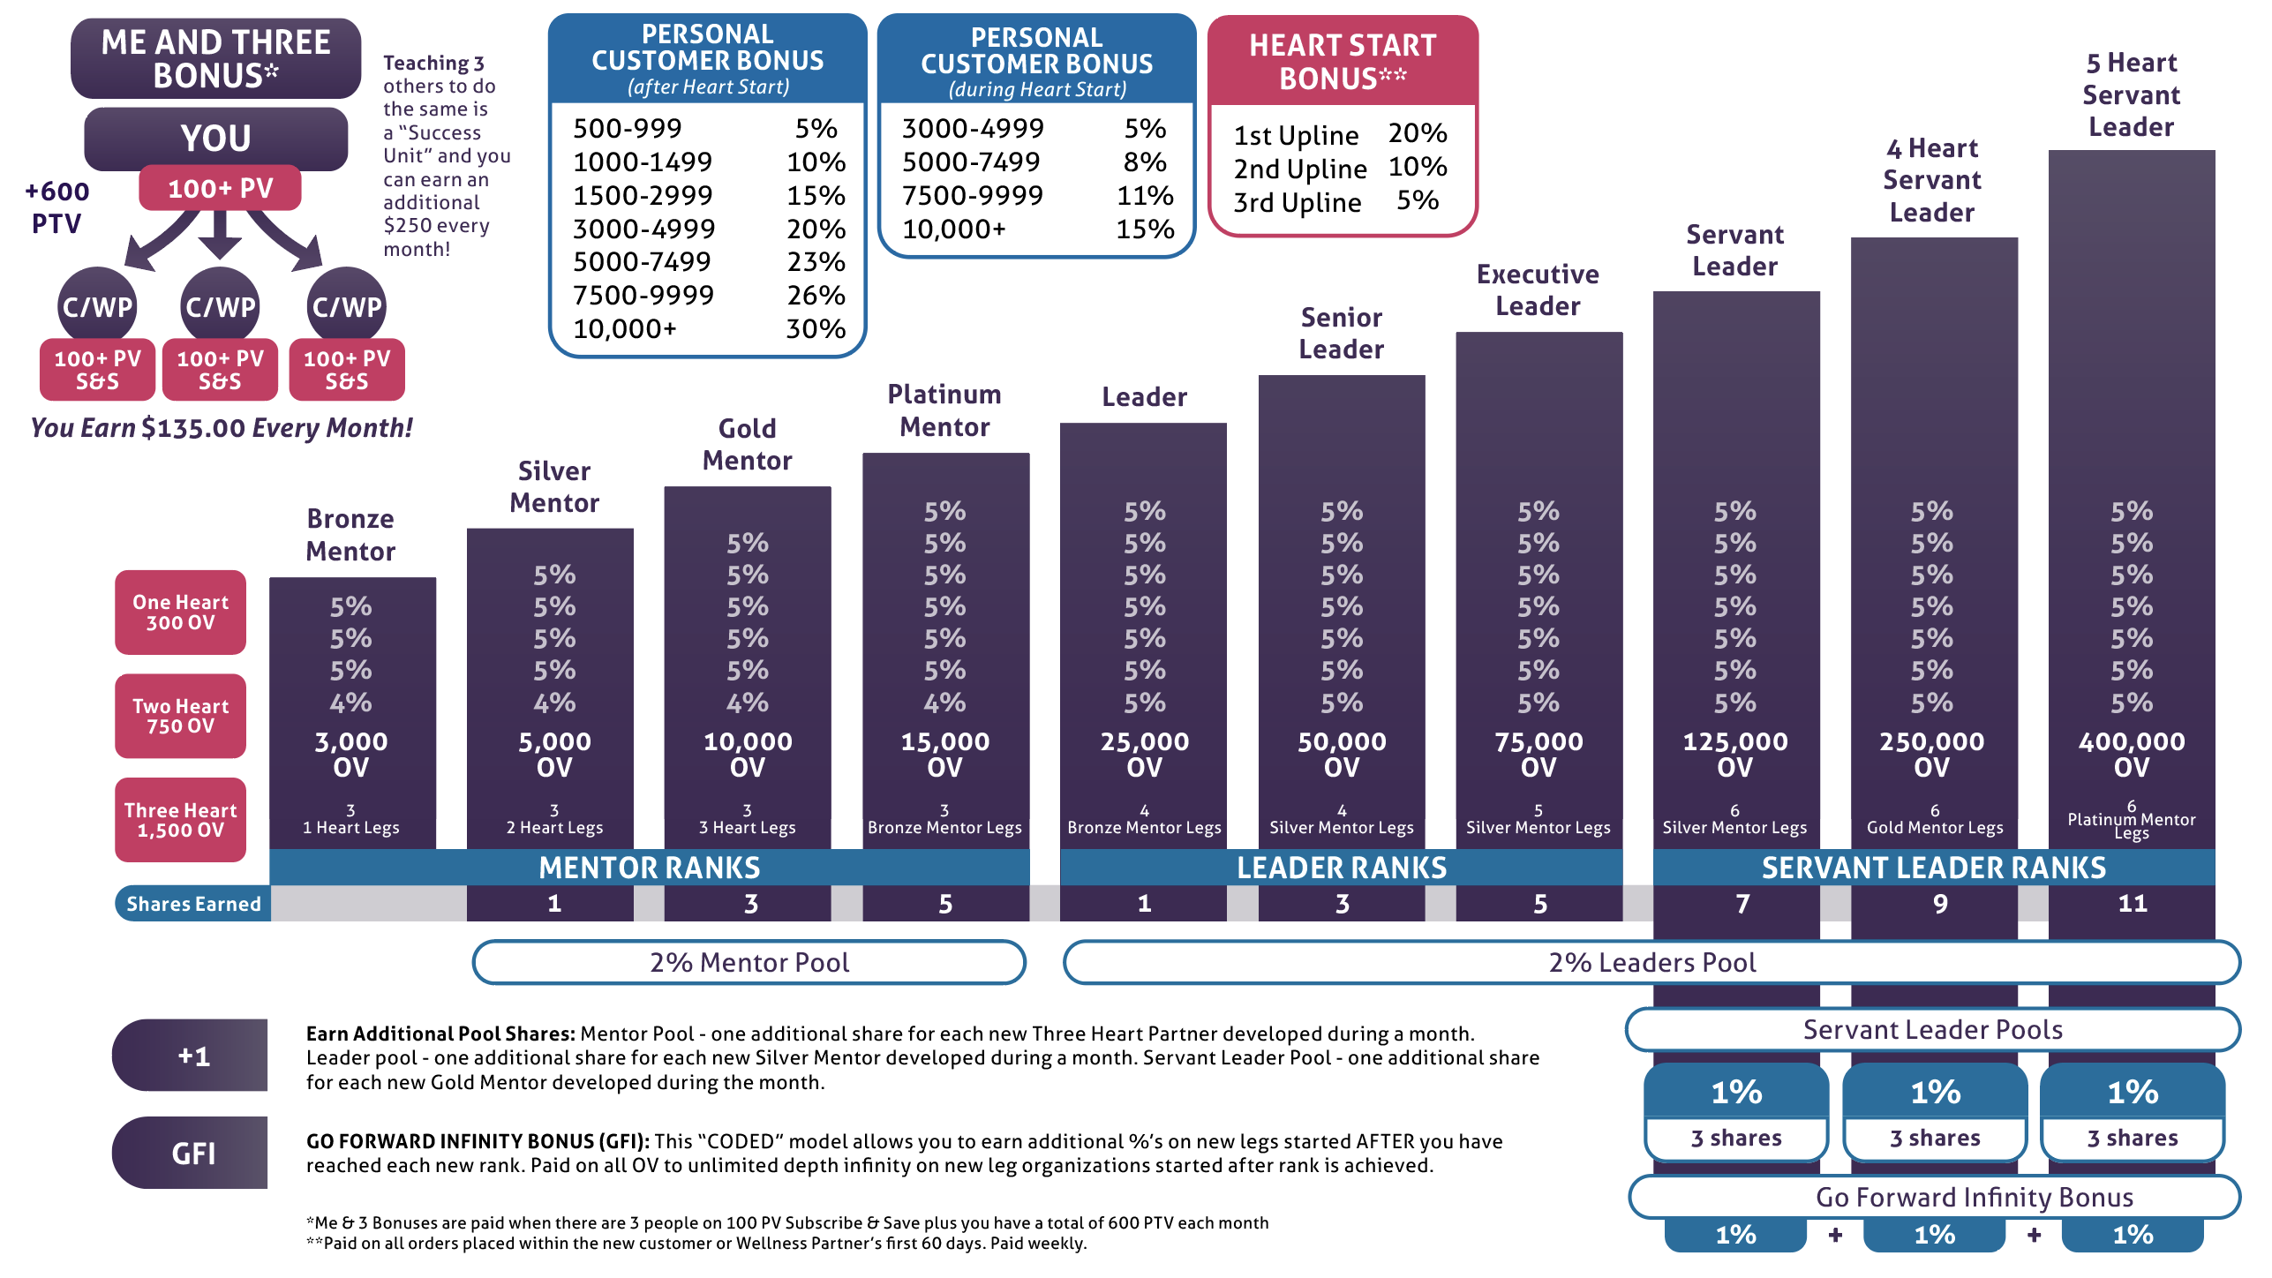

Slide 32

EXTENDED
THROUGH SEPTEMBER!

Slide 33


EXTENDED
THROUGH SEPTEMBER 30th!

Slide 34
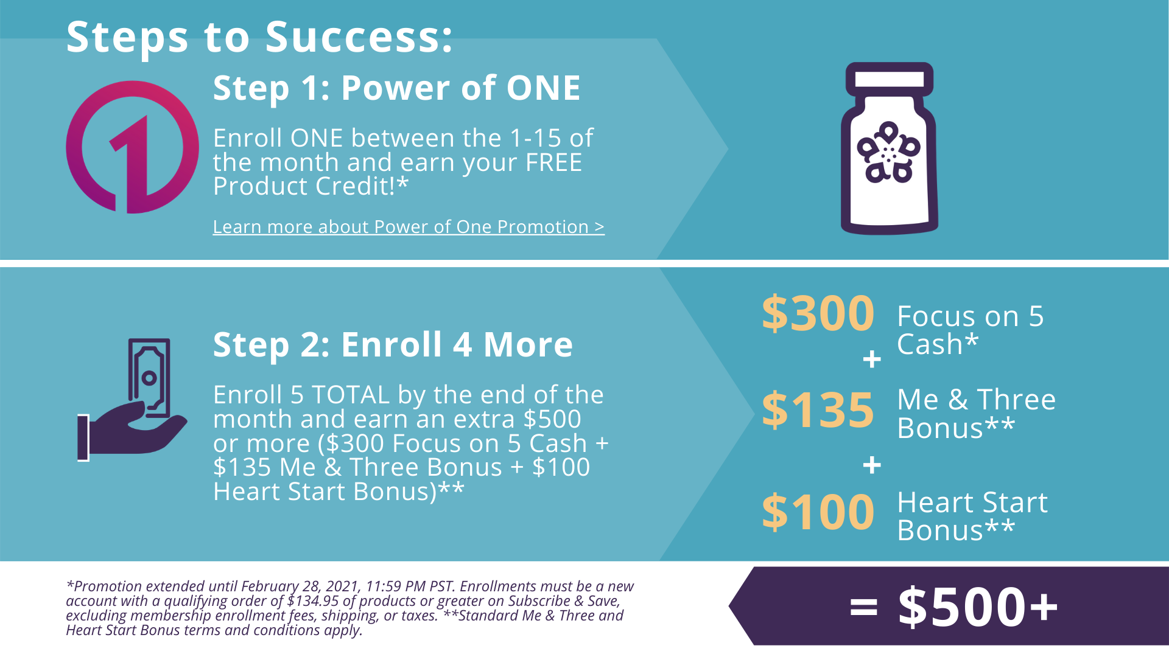
EXTENDED
THROUGH SEPTEMBER 30th!

Slide 35
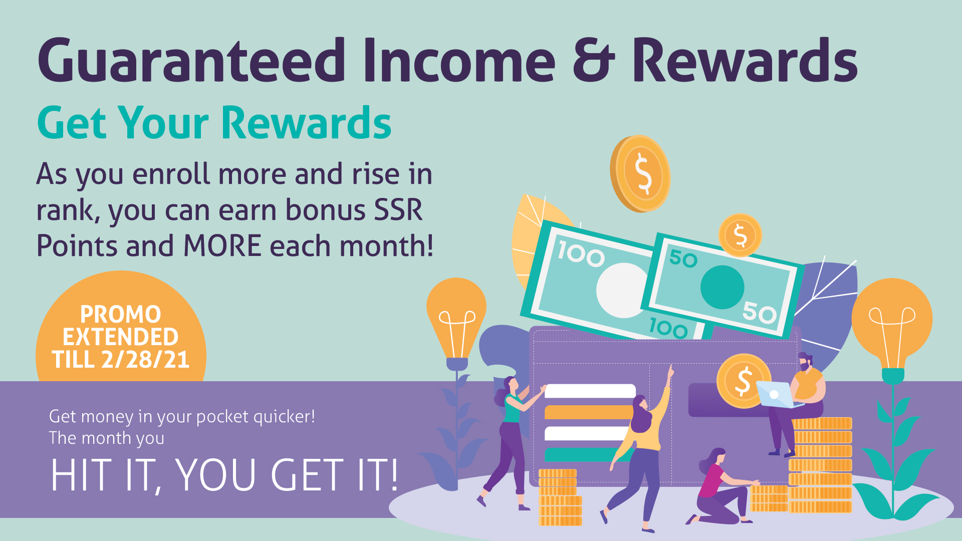
EXTENDED
THROUGH SEPTEMBER 30th!

Slide 36
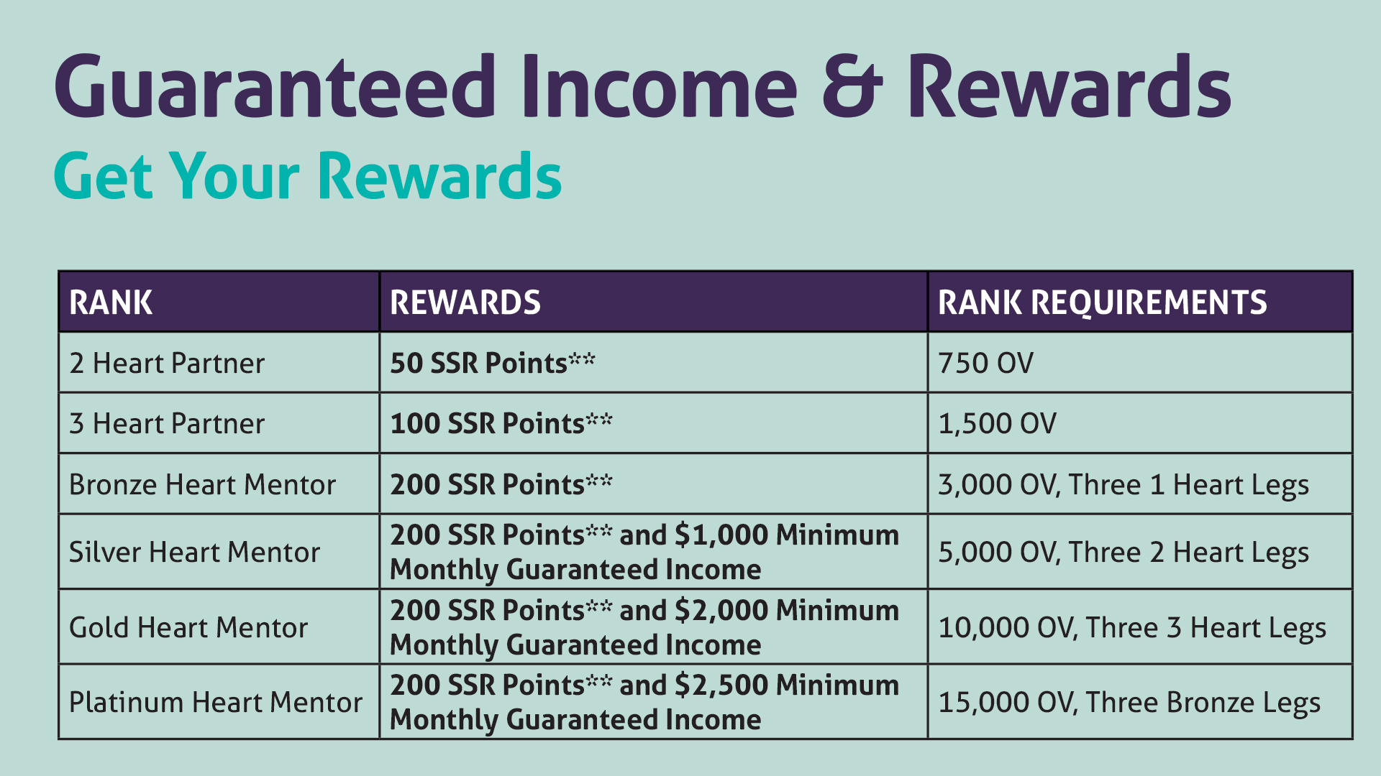
ALSO EXTENDED
THROUGH SEPTEMBER 30th!

Slide 37
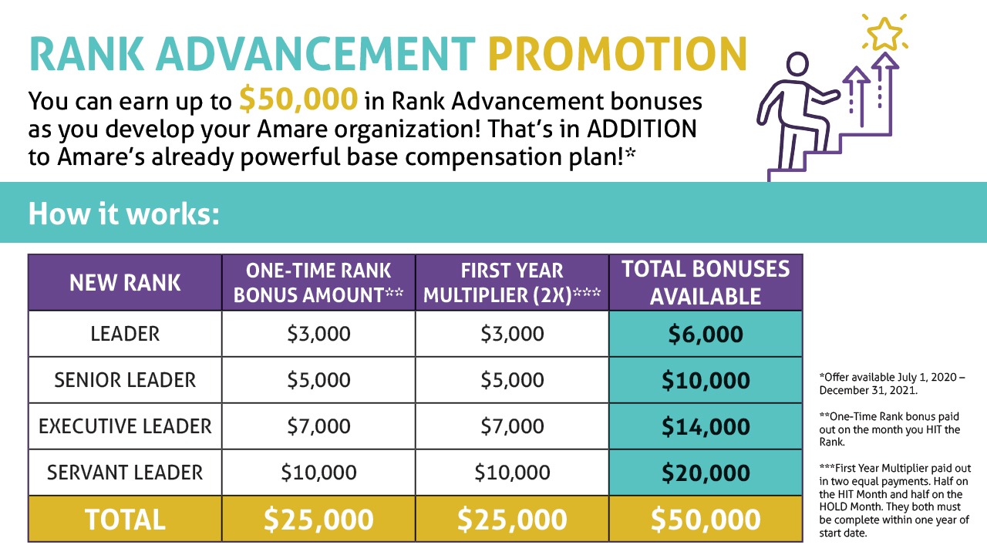

Slide 38


Slide 39
HUGE MARKET!
Global Mental Wellness Industry:
$120.8 billion in 2019
Self-Improvement
$33.6b
Brain-Boosting Nutraceuticals & Botanicals
$34.8b
Mental Wellness Projected
Trillion $ Market
Meditation & Mindfulness
$2.9b
Senses, Spaces & Sleep
$49.5b

Slide 40

RIGHT PLACE. RIGHT TIME.
SOCIAL SHIFT AROUND MENTAL WELLNESS IS HAPPENING NOW
The world health organization calls stress “the health epidemic of the 21st century” with more than 350 million people affected around the world.

Slide 41
THE TREND IS YOUR FRIEND
Mental Wellness
Gut Health
Financial Stress
Gig Economy

Slide 42

Category Creator Emerging As
THE
Category DOMINATOR

Slide 43

WE ARE THE MENTAL WELLNESS COMPANY
We even made it OFFICIAL!

Slide 44

A VERY DIFFERENT KIND OF COMPANY
On a mission that can make a meaningful difference in the lives of others

Slide 45
Why amare – for business builders
Rank Advancement Bonuses & Legacy Leader Pool
Product Consumption 200% HIGHER than other companies
Retention DOUBLE other companies
Current trends for you to build a BUSINESS

Slide 46
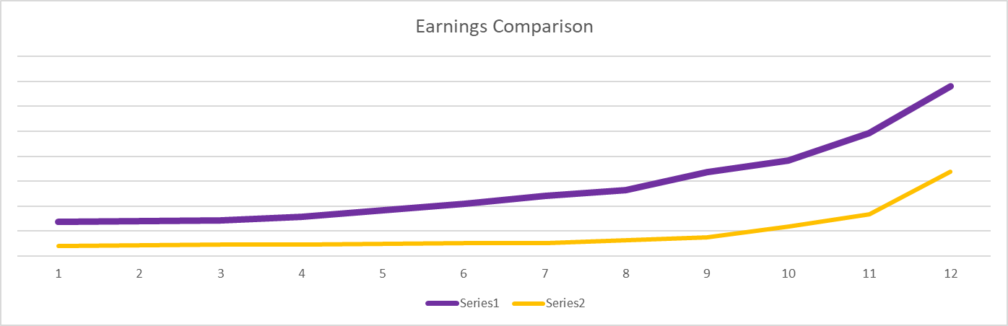
Amare earnings vs industry earnings
Amare example = $33,680.40
Industry example = $10,918.13

Slide 47

KEY STATISTICS
At AMARE
People joining our community up OVER 250% vs Feb
Individuals adding new customers up 117% vs Feb
246% more of our partners making > $500/mo.

Slide 48
START UP
GROWTH
HYPER-GROWTH
LEGACY GROWTH
Formulation
& Foundation
Concentration
& Expansion
Momentum
& Explosive Growth
Stability
& Legacy
ONLY HAPPENS ONCE!
We Are Here!
Critical Mass
“Tipping Point”
1-3 Years
4-10 Years
10+ Years

Slide 49

MONEY in the hands of good people can do great things

Slide 50

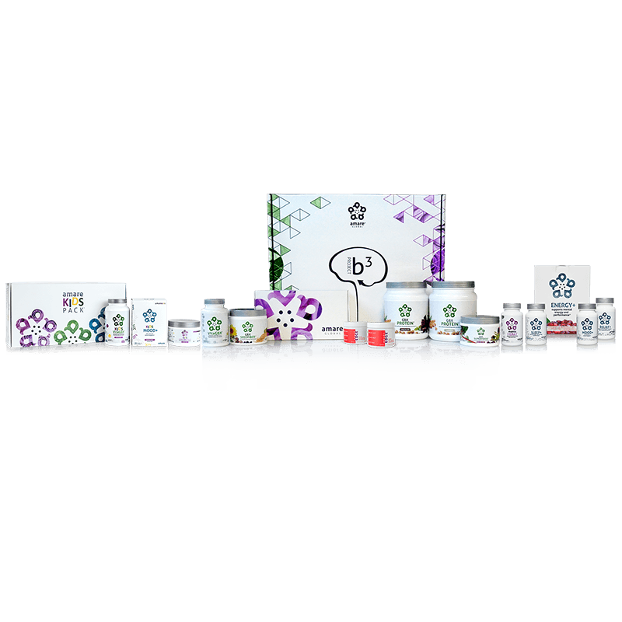
THE SMART CHOICE
$749.95 (400PV)
150 Trip Points
187 SSR Points
25% SSR Earning Rate
20 FREE Samples ($79.90 Value)
$69.95 Membership Fee Waived
THE ULTIMATE BUSINESS BUILDER STARTER PACK
Amare Launch Pack
Launch your Amare business with all our TOP product packs and special offers

Slide 51
Launch Pack Behavior
The Question: Is there a difference in performance of Wellness Partners who enrolled with a Launch Pack compared to those who did not enroll with a Launch Pack?
The Answer: YES.

Slide 52
Launch Pack Activity
WPs who enroll with a Launch Pack:
  Complete 58%
  more orders
  Spend 41%
  more per order
  Spend 223%
  more in total
  Send twice
  as many samples

Slide 53
Launch Pack RESULTS
WPs who enroll with a Launch Pack:
  Enroll 2X
  as many accounts
  Earn 4X
  more commissions
  Have 5X
  larger organizations
  Are 3X more likely to achieve the rank of Bronze or above

Slide 54
Why the Higher Performance?
Personal experience
with ALL Amare products.
  Higher probability for personal testimonials.
  More confidence talking about products.
2. The psychology of
upfront commitment!
  More “skin in the game” up
  front raises the bar.
  Creates healthy pressure to get
  into action sooner.
  Goals are set to make the
  upfront investment pay off.

Slide 55
Thank you!

