Slide 1
AMARE GLOBAL PRESENTATION

Slide 2
amare
/a·mà·re/
“to love”
Love yourself first and everything else falls into place

Slide 3
OUR MISSION
To create a holistic mental wellness platform of products, programs, and people.
Core Values: Love, Integrity, Innovation, Service, and Humility

Slide 4
We believe that MENTAL HEALTH is just as important as PHYSICAL HEALTH

Slide 5
We Also Believe…
Almost ALL OF US grew up learning about how to take care of our PHYSICAL HEALTH.
Almost NONE OF US grew up learning about how to take care of our MENTAL HEALTH.

Slide 6
WHAT IS MENTAL WELLNESS?
MENTAL FITNESS
CONFIDENCE
Well… IT’S EVERYTHING
STRESS RESILIENCE
PHYSICAL PERFORMANCE
FINANCIAL WELLNESS

Slide 7
HUGE MARKET!
Global Mental Wellness Industry:
$120.8 billion in 2019
Self-Improvement
$33.6b
Brain-Boosting Nutraceuticals & Botanicals
$34.8b
Mental Wellness Projected
Trillion $ Market
Meditation & Mindfulness
$2.9b
Senses, Spaces & Sleep
$49.5b

Slide 8
Category Creator Emerging As THE Category DOMINATOR

Slide 9
WE ARE THE MENTAL WELLNESS COMPANY
We even made it OFFICIAL!

Slide 10
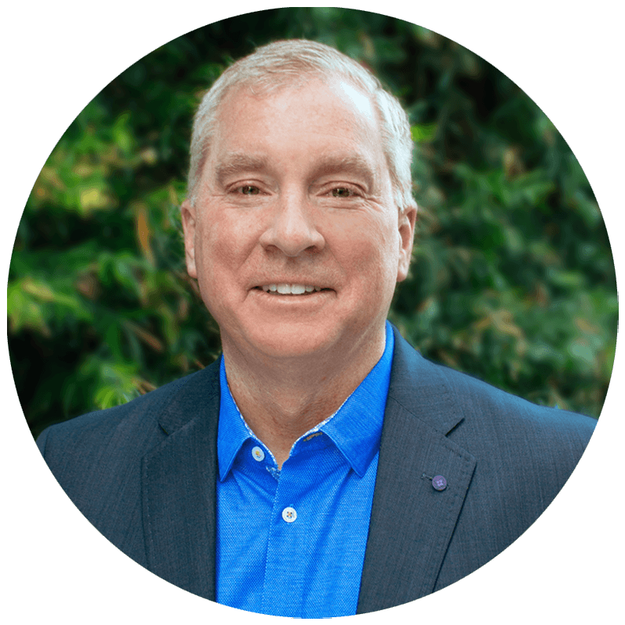
MEET OUR TEAM
HIEP TRAN
CEO & Founder
SHAWN TALBOTT
Chief Science Officer
MIKE BROWN
Chief Marketing Officer
MARK NGUYEN
Chief Technology Officer
KENT WOOD
Chief Financial Officer

Slide 11
Helping people level-up
Mood
Motivation
metabolism
Mental Fitness
Stress Resilience
Confidence & Weight
Gut Health
Financial Wellness

Slide 12
SCIENCE BEHIND THE PRODUCTS
Microbiome Research
Human Genome Project
Ancient Wisdom
Emerging Discoveries
Modern Innovation

Slide 13
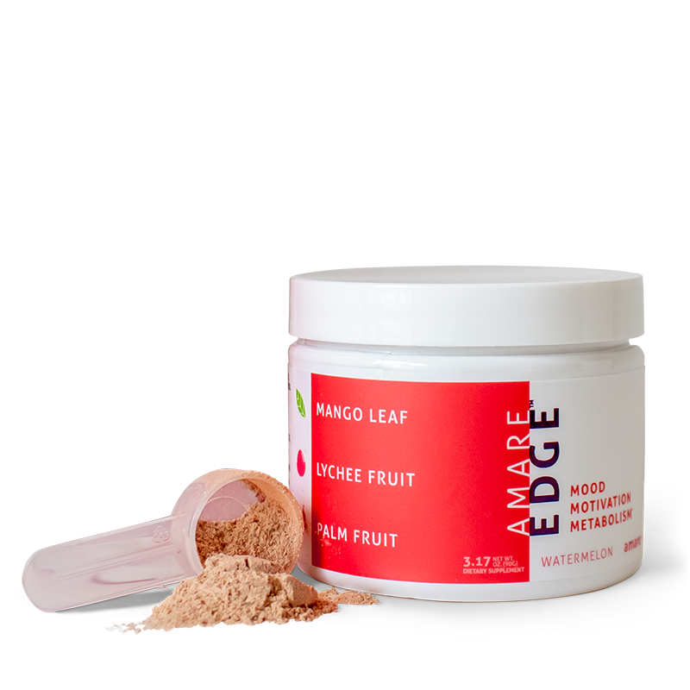
GET YOUR AMARE EDGE
Instantly improve your mood, motivation, and metabolism*
Immediate brain power and physical energy*
Progressive anti-aging benefits and loss of belly fat over time*

Slide 14
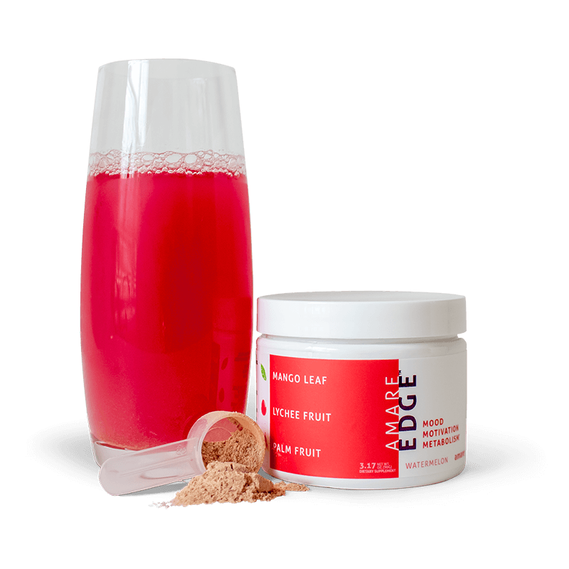
NEVER-BEFORE COMBINED
POWERFUL INGREDIENTS
MANGO LEAF
Motivation
LYCHEE FRUIT
Metabolism
PALM FRUIT
Mood

Slide 15
METABOLISM
FAMILY
GET YOUR
MOOD
WORK
MOTIVATION
ACTIVE

Slide 16
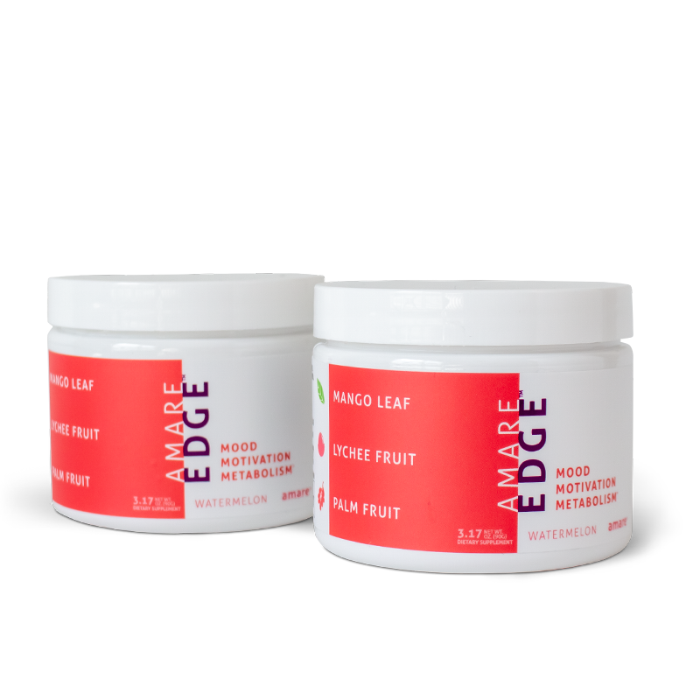
MENTAL FITNESS
PHYTONUTRIENTS
MOOD. MOTIVATION. METABOLISM.
STRESS Resilience
MICROBIOME/PRO/ PREBIOTICS
Confidence & Weight
ESSENTIAL NUTRIENTS
GUT HEALTH
MICROBIOME BOOSTING NUTRIENTS
Amare EDGE
The game changer that will transform your everyday life.
Financial Wellness
ULTIMATE BUSINESS STARTER PACK

Slide 17
NUTRITION FOR KIDS & TEENS
Supports full mind and body nutrition for growing kids and teens*
Promotes immune system efficiency*
Improves concentration, attention and mental alertness*
Reduces stress hormones and inflammation*
Provides comprehensive mood support and stress resilience*
Improves psychological vigor (physical energy, mental acuity and emotional wellbeing)*
Normalizes neurotransmitter activity, including serotonin and dopamine*
Supports memory improvement and efficiency*
Amare Kids Pack
The first comprehensive mental wellness pack for kids and teens — nutrition for mind and body.*

Slide 18
SPECIAL BOOSTER FOR MOOD, SLEEP & PAIN RELIEF
Help boost mood and stress resilience*
Support increased sleep quality*
Help alleviate body aches and pains*
HempGBX+
The full-spectrum, premium hemp oil that naturally supports the body’s endocannabinoid system.*

Slide 19
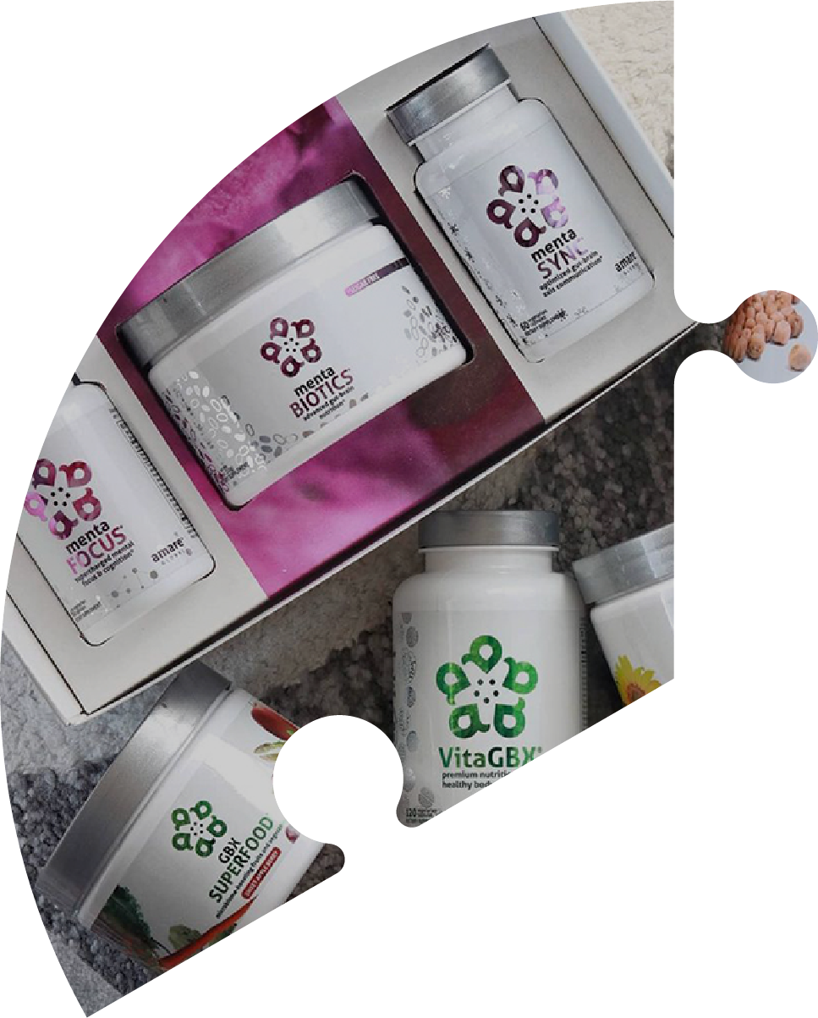
Amare PLATFORM:
PRODUCTS
PROGRAMS
The puzzle pieces that provide the ultimate platform the world has never seen before.
PEOPLE

Slide 20
Why amare – for business builders
Rank Advancement Bonuses & Legacy Leader Pool
Product Consumption 200% HIGHER than other companies
Retention DOUBLE other companies
Current trends for you to build a BUSINESS

Slide 21
Amare earnings vs industry earnings
Amare example = $33,680.40
Industry example = $10,918.13

Slide 22
RIGHT PLACE. RIGHT TIME.
SOCIAL SHIFT AROUND MENTAL WELLNESS IS HAPPENING NOW
The world health organization calls stress “the health epidemic of the 21st century” with more than 350 million people affected around the world.

Slide 23
A VERY DIFFERENT KIND OF COMPANY
On a mission that can make a meaningful difference in the lives of others

Slide 24
START UP
GROWTH
HYPER-GROWTH
LEGACY GROWTH
Formulation & Foundation
Concentration & Expansion
Momentum & Explosive Growth
Stability & Legacy
ONLY HAPPENS ONCE!
We Are Here!
Critical Mass
“Tipping Point”
1-3 Years
4-10 Years
10+ Years

Slide 25
THE TREND IS YOUR FRIEND
Mental Wellness
Gut Health
Financial Stress
Gig Economy

Slide 26
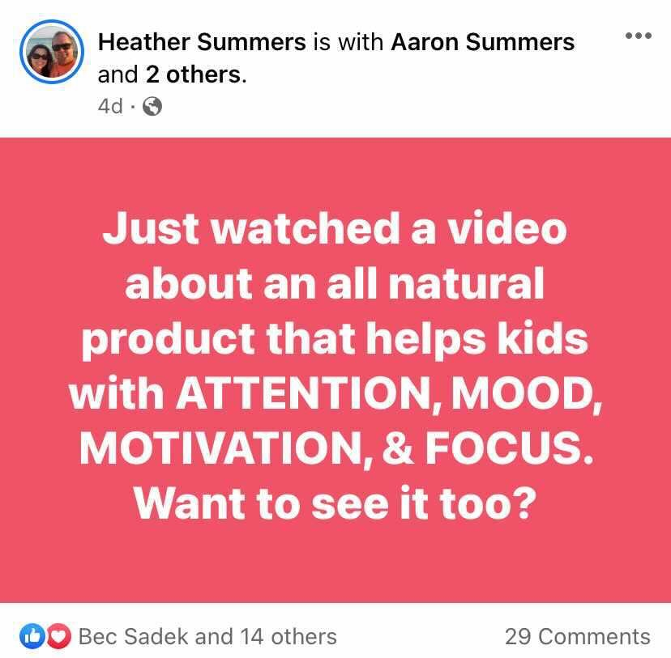
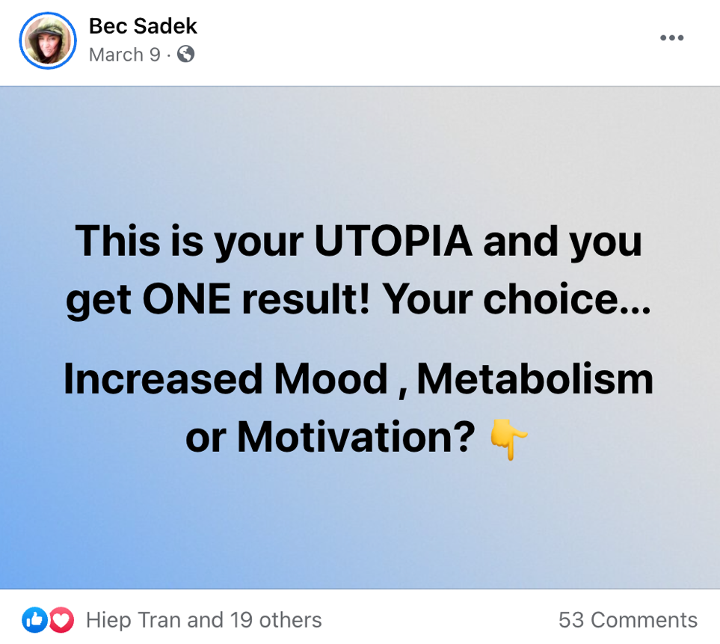
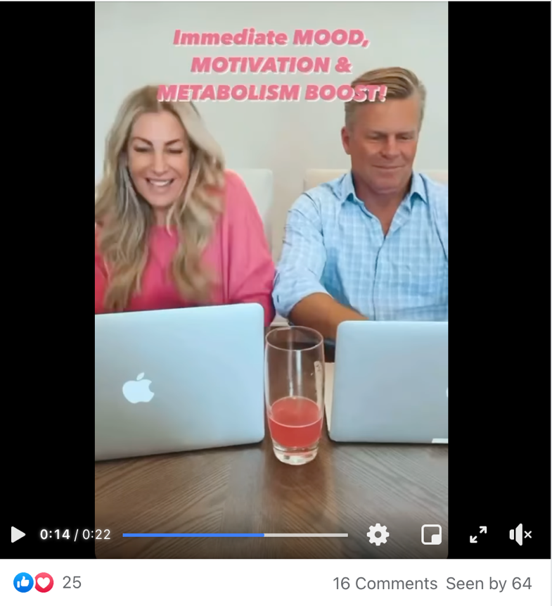
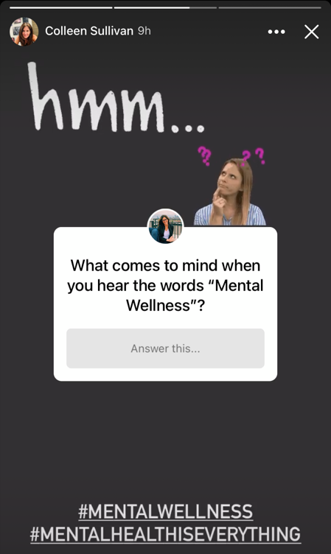
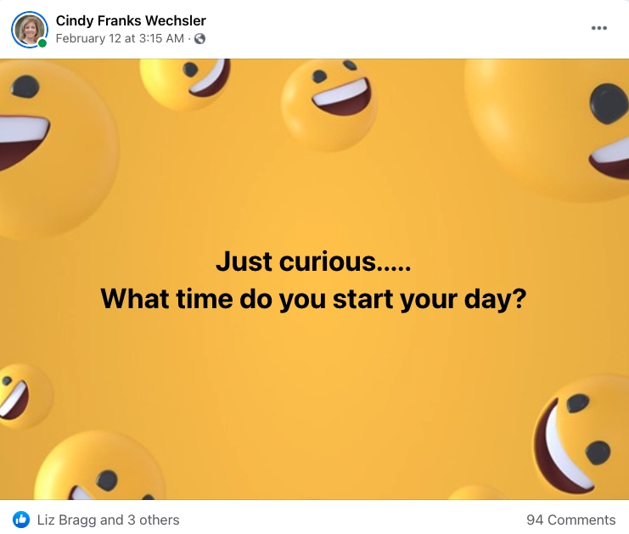
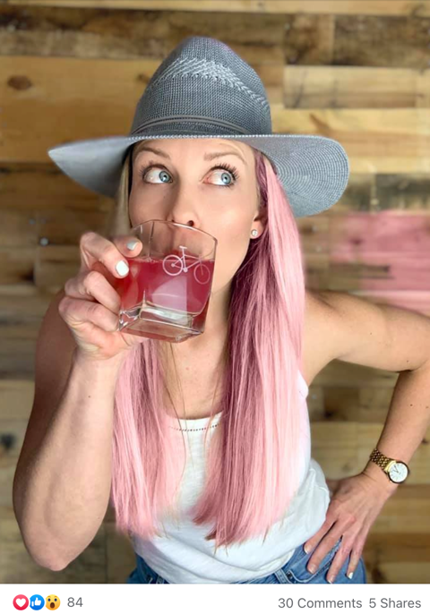
Amare ATTRACTION MARKETING System
BRINGING PEOPLE TO YOU
A powerful marketing strategy that utilizes products, services, and/or valuable information to attract people and get lead generation.

Slide 27
AMARE ATTRACTION MARKETING SYSTEM
Take Advantage of Social Media
SIMPLE
1-2-3-4 Step Method
Not just a system…but something that itself is a reason to join Amare from a business perspective!
BRING PEOPLE TO YOU
EASILY DUPLICATABLE

Slide 28
”ATM” Facebook Groups
GROUP 1
GROUP 2
GROUP 3

Slide 29
MONEY in the hands of good people can do great things

Slide 30
Amare Compensation Plan Overview
Focus on customer gathering
Provide DIRECTION and FOCUS
FAIR and BALANCED
Never penalize success
Reward progress
Reward leadership
Incentivize teamwork
Provide EARLY REWARDS (for spare time involvement)
Provide UNLIMITED REWARDS (for career income potential)
What makes for a great compensation plan?
ALL OF THIS

Slide 31
AMARE Compensation Plan
UNILEVEL
ME & THREE
ME & THREE
EARN SPECIAL BONUSES & REWARDS THROUGH OUR UNIQUE COMPENSATION PLAN
Pools
Guaranteed Financial Income
AND SO MUCH MORE!

Slide 32
Los Cabos, Mexico
Nov. 15-20, 2021

Slide 33
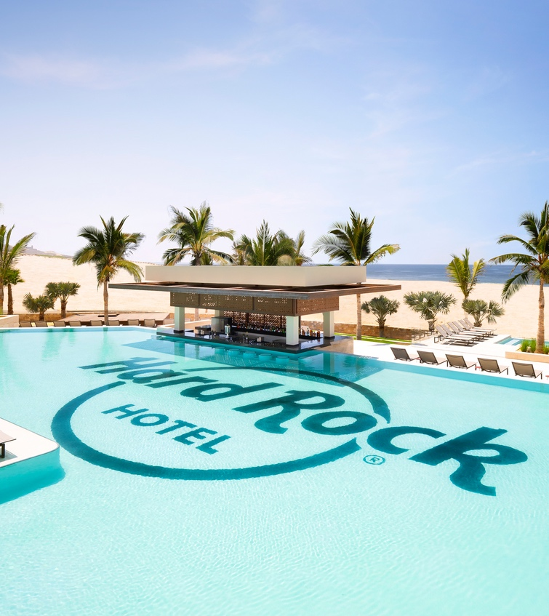
Hard Rock Los Cabos
An All-Inclusive Resort
New Customers & Wellness Partners = POINTS!
Enough POINTS = FREE TRIP!

Slide 34
100% SATISFACTION GUARANTEE
EVALUATE THE PRODUCTS FOR YOURSELF RISK FREE
We offer a complete line of products focused on mental wellness. You can evaluate our products for yourself and if at any time you are not completely satisfied, we will fully refund your purchase. Period.
Visit amare.com to view full return policy.

Slide 35
CUSTOMER Use a Personal Promo Code & Get $10 OFF Your First Order
Enjoy premium, natural, effective products
WELLNESS PARTNER $69.95/year
Enjoy premium, natural, effective products
Share Amare in a fun, purposeful, and engaging way, while earning an income

Slide 36
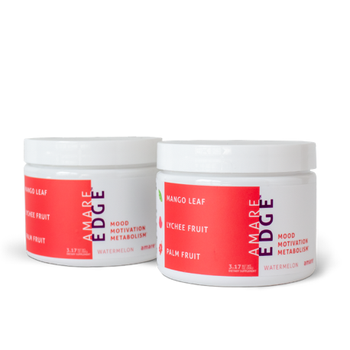
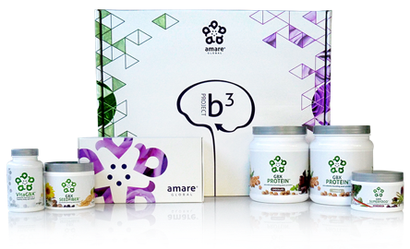
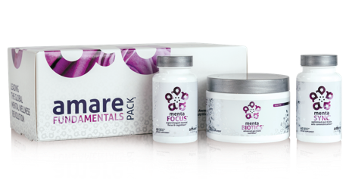
AMARE SOLUTIONS
Favorites
Essentials
Real Deal
MOOD MOTIVATION
METABOLISM
STRESS RESILIENCE
MENTAL FITNESS
GUT HEALTH
KIDS & TEENS
CONFIDENCE & WEIGHT
FINANCIAL WELLNESS
Amare EDGE 2-Pack
Amare FundaMentals Pack
Mental Fitness Pack
GBX Foods System
Amare Kids Pack
B3 Body Pack
Amare Launch Pack
The game changer that will transform your everyday life
The world's first award-winning gut-brain axis nutrition system
Fuel your mental edge with all-natural products in our mental fitness pack
Plant-based, microbiome-boosting nutrients to help round out your daily nutrition*
The first comprehensive mental wellness pack for kids and teens — nutrition for mind and body*
The modern "un-diet" solution to fuel a healthy lifestyle
Launch your Amare business with all our TOP product packs and special offers
$129.95 S&S
$134.95 S&S
$139.95 S&S
$85.95 S&S
$117.95 S&S
$274.95 S&S
$749.95

Slide 37
THE SMART CHOICE
$749.95 (400PV)
150 Trip Points
187 SSR Points
25% SSR Earning Rate
20 FREE Samples ($79.90 Value)
$69.95 Membership Fee Waived
THE ULTIMATE BUSINESS BUILDER STARTER PACK
Amare Launch Pack
Launch your Amare business with all our TOP product packs and special offers

Slide 38
Are YOU Ready to Join the Mental Wellness Revolution?

Slide 39
CONNECT VIRTUALLY
Join our weekly scheduled live calls on Zoom or Facebook to continue learning about the Amare Business and Science. ALL are welcome, so invite new people to attend!

Slide 40
Monday 11 AM: Business Of Amare Masterclass (FB Group 2)
Tuesday 11 AM: Science Social Hour (FB Group 1)
Wednesday 2 PM: Corporate Announcements & Recognition (FB Group 3)
Thursday 9 AM: Amare Attraction Marketing System Training (FB Group 3)
Saturday 8 AM: Leadership Chat & Check-In (FB Group 3)

Slide 41
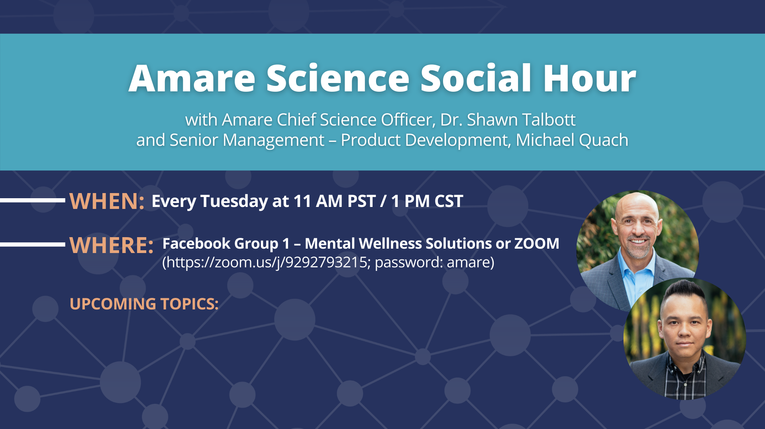
Tuesday, June 1 (Dr. Shawn): Brain Health Awareness Month — Did You Know We Have THREE Brains?
Tuesday, June 8 (Dr. Shawn): Best Friends Day — The Power of Connections
Tuesday, June 15 (Michael): Brain Health Awareness Month — Brain Wellness 101
Tuesday, June 22: No Science Social Hour Call
Tuesday, June 29 (Dr. Shawn): Amare Product Line Overview

Slide 42
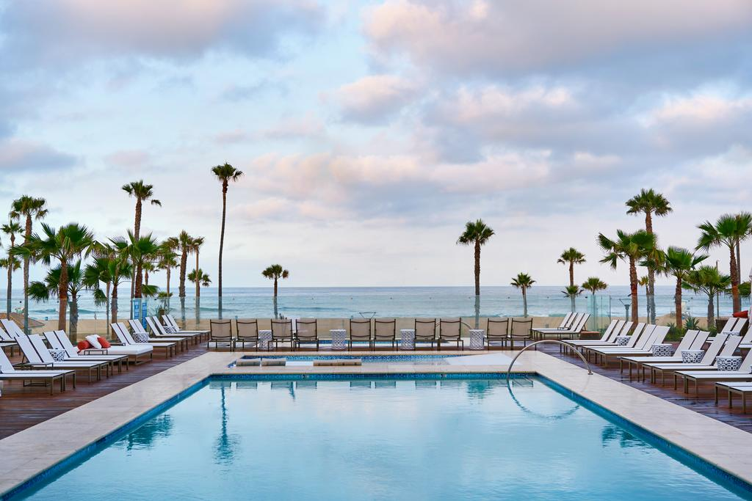
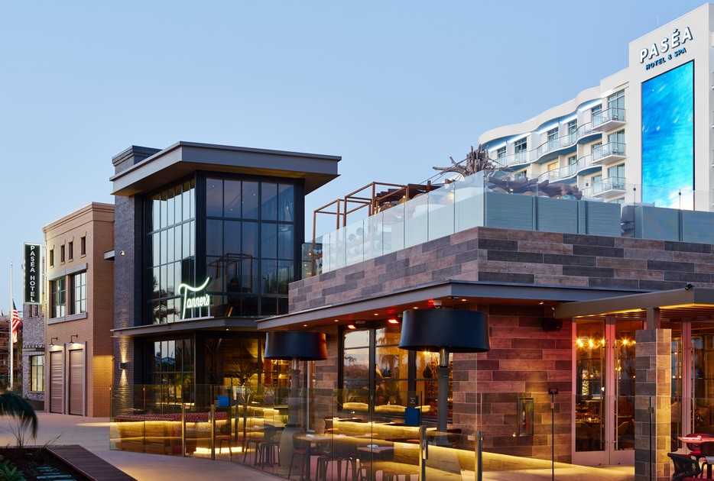
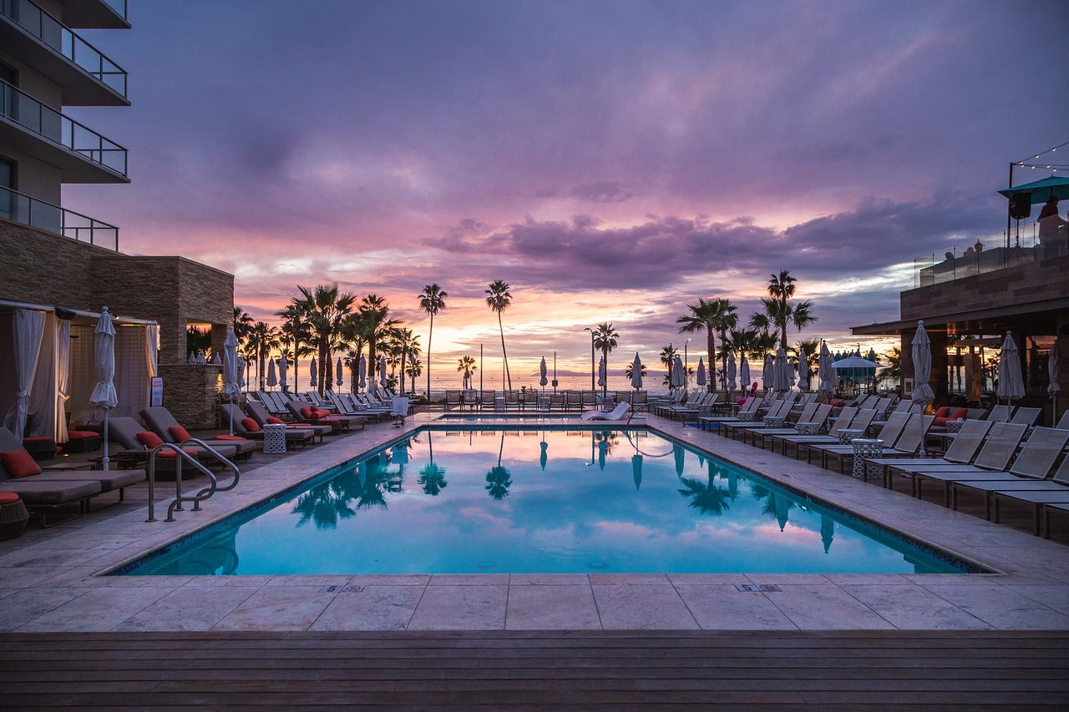
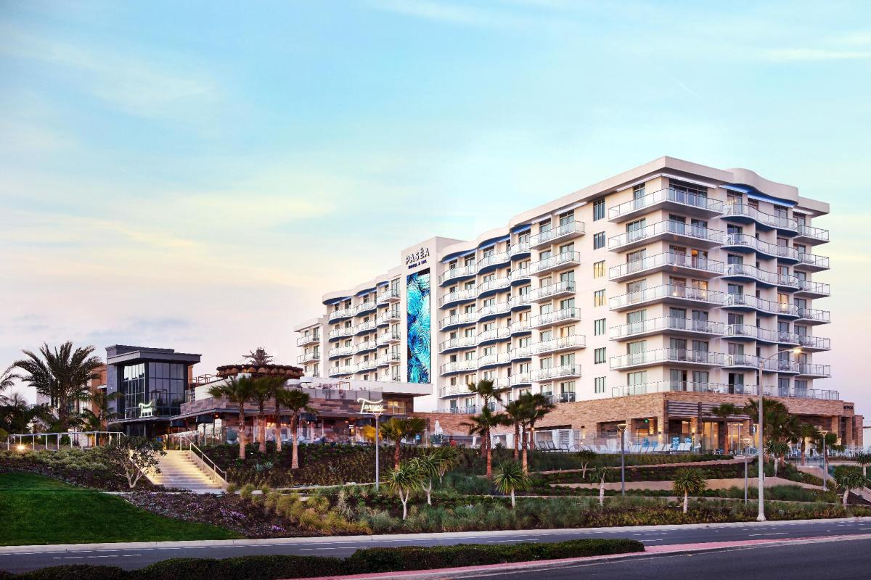
Amare Hybrid Event (In-person and Virtual)
When: Thursday, Sept. 16 & Friday, Sept. 17
Where: Pasea Hotel and Spa Huntington Beach, CA

Slide 43
H2H 2021 TICKET SALES
In-Person Tickets: $399
June 2nd: Gold and above only
June 9th: Silver and above
June 16th: Bronze and above
Virtual Tickets:
Tickets go on sale on July 1st
(price will increase on August 1st)

Slide 44
H2H 2021 TICKET SALES
This ticket gets you access to the in-person event on Thursday, Sept 16 and Friday, Sept 17, and more:
Welcome Reception
VIP Swag Pack
Access to All General Sessions
Social Hours and Cocktail Receptions with Amare Showcase
Beach Morning Workout
Intimate Networking//Exclusive VIP Experience at Beach-Front Resort in Southern California
Evening Gala and Dinner
Find link to the hotel accommodations on the event registration site.
In-Person Tickets: $399
June 2nd: Gold and above only
June 9th: Silver and above
June 16th: Bronze and above

Slide 45
H2H 2021 TICKET SALES
This ticket gets you access to the in-person event on Thursday, Sept 16 and Friday, Sept 17, and more:
Swag Bag
Access to All General Session
Online Platform Access with event app and interaction features
Chat
QA
Polls
Video Chat Rooms
Pre-recorded trainings and content
Post-event access to recorded content and General Sessions for 3 months
Virtual Tickets:
Tickets go on sale on July 1st
(price will increase on August 1st)

Slide 46
Amare guests get a special room rate of $250 per night, instead of the normal rate of $600+, at the Paséa Hotel & Spa in Huntington Beach, CA.

Slide 47
2021 Heart2Heart FAQs
What are the hotel accommodations for the in-person event?
You can make your hotel reservation at the Paséa Hotel & Spa in Huntington Beach, CA using the link on the event registration site. Amare has negotiated a special room rate for this ocean-front property of $250 per night. All rooms have an ocean view. Please note the cancellation policies on the hotel’s website.
Can my spouse attend this event?
Yes, spouses must purchase their own ticket. The event is one ticket per one person (not one ticket per couple). We welcome all spouses that have purchased the In-Person Attendee All-Access Pass.
How many tickets can I buy on my account?
As tickets go on sale based on ranks, you will be permitted to purchase up to two (2) In-Person All-Access Passes per account. This is where you can purchase your spouse’s ticket.
If I purchase the In-Person Ticket, do I get access to the virtual ticket as well?
Yes, the In-Person Ticket gives you access to both the in-person and virtual events.

Slide 48
2021 Heart2Heart FAQs
How does COVID-19 affect this event?
Due to restrictions surrounding the pandemic, we have limited seating available for the in-person event. For this reason, in-person event tickets will be available to Bronze and above ranks first. As we move forward, we will look to the state of California for updates to regulations regarding the pandemic. As always, the safety and well-being of our community will always be our number one priority. If you are traveling to Southern California for this event, please be sure to check the cancellation policies regarding room and airfare.
For more information on the 2021 Heart2Heart event, please visit amare.com/events.

Slide 49
CURRENT PROMOTIONS

Slide 50
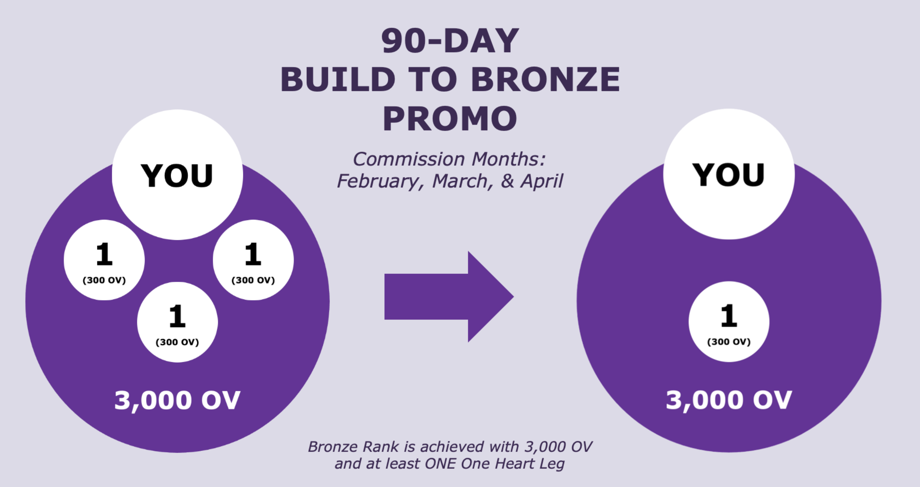
EXTENDED TO SEPTEMBER 30th!

Slide 52
EXTENDED THROUGH SEPTEMBER!

Slide 53
EXTENDED THROUGH SEPTEMBER 30th!

Slide 54
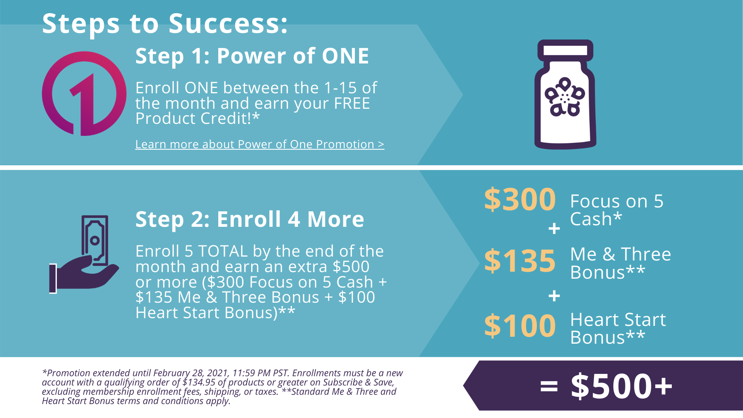
EXTENDED THROUGH SEPTEMBER 30th!

Slide 55
EXCLUSIVE JUNE PROMOTION:
ADDITIONAL REWARDS FOCUS ON FIVE
1 Product Credit for 1 Amare EDGE 2-Pack
Limited-Edition Amare EDGE T-Shirt
+

Slide 56
EXTENDED THROUGH SEPTEMBER 30th!

Slide 57
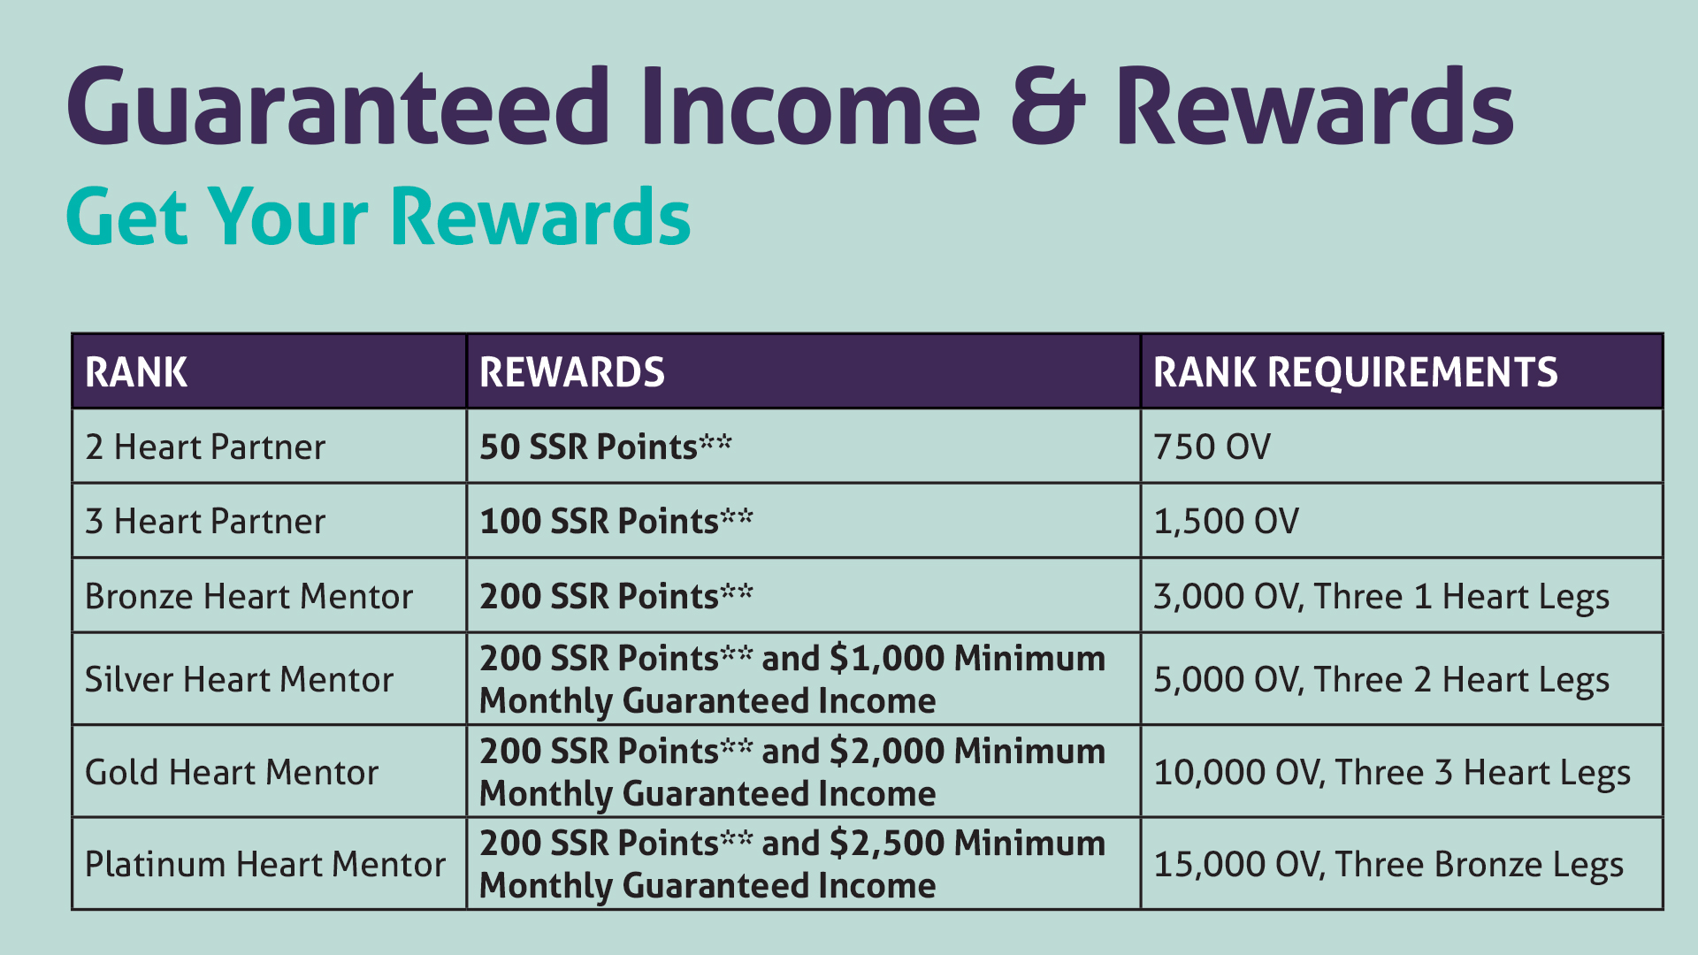
ALSO EXTENDED THROUGH SEPTEMBER 30th!

Slide 58
